Slide 1
Unit 2: Properties and changes of matter
Part one: Classifying Matter
Part two: Physical and chemical properties/changes
www.middleschoolscience.com 2009

Slide 2
Classifying Matter:
Elements, Compounds, and Mixtures
www.middleschoolscience.com 2009

Slide 3
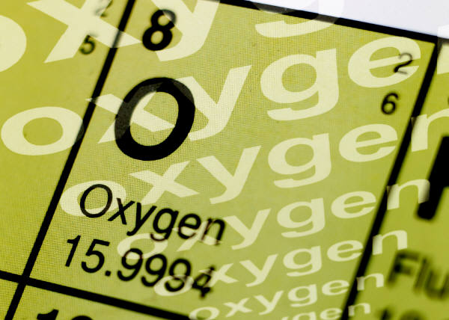
Pure Substances
A sample of matter that has definite chemical and physical properties.
Elements
Atoms
Compounds
Molecules

Slide 4
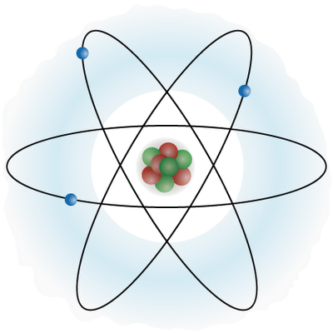
Atoms
Atoms contain Protons
and Neutrons in a tiny
nucleus and Electrons in a
cloud around the nucleus.
  http://youtu.be/lP57gEWcisY

Slide 5

Elements
pure substance that cannot be separated into simpler substance by physical or chemical means.

Slide 6
Compounds
Pure substance composed of two or more different elements joined by chemical bonds.
  Made of elements in a specific ratio
  that is always the same
  Has a chemical formula
  Can only be separated by
  chemical means, not physically
H₂O
NaCl
CO₂

Slide 7
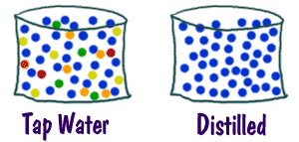
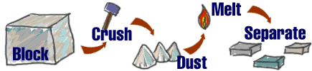
Mixtures
A combination of two or more pure substances that are not chemically combined.
substances held together by physical forces, not chemical
No chemical change takes place
Each item retains its properties
in the mixture
They can be separated physically
Chem4kids.com

Slide 8
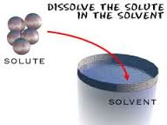
How do Solutions/Mixtures Form???
The substance that dissolves is called the Solute
The substance that seems to stay is called the Solvent

Slide 9
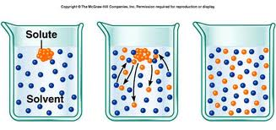
Solute vs. Solvent

Slide 10
Examples of Solute & Solvent mixtures:
Solute | Solvent

Slide 11
More terms related to solutions
(liquid mixtures)
Saturated: a solution that is holding all the solute it can
  Imagine a paper towel being saturated with water.
Concentration: is a measurement of how much solute is present compared to the amount of solvent.
Solubility: The ability to dissolve; is a measurement that describes how much solute dissolves in a given amount of solvent.
Insoluble: a substance is unable to dissolve

Slide 12
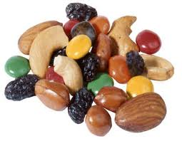
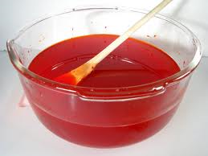
Different kinds of mixtures
Homogeneous vs. Heterogeneous Mixtures
Homogeneous: Substances that are mixed evenly
Heterogeneous: Substances that are mixed unevenly
  Can you identify the heterogeneous mixture below compared to the homogeneous?

Slide 13
Can you identify the following?
You will be shown a series of photos. Tell if each photo represents an item composed of an element, compound, or mixture.
Review:
An element contains just one type of atom.
A compound contains two or more different atoms joined together.
A mixture contains two or more different substances that are only physically joined together, not chemically.
  A mixture can contain both elements and compounds.

Slide 14

Element, Compound, or Mixture?
Rocks

Slide 15
Element, Compound, or Mixture?
Rocks

Slide 16
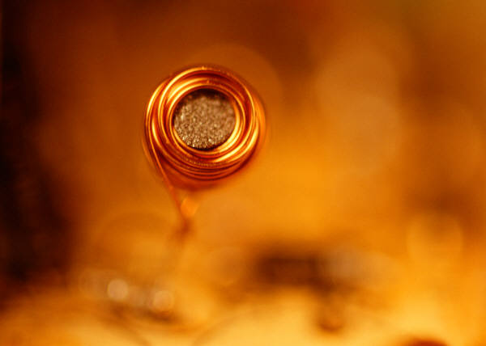
Element, Compound, or Mixture?
Copper

Slide 17
Element, Compound, or Mixture?
Copper
Cu

Slide 18
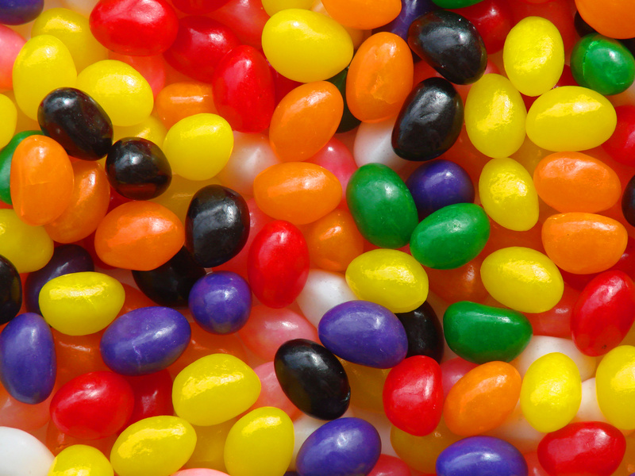
Element, Compound, or Mixture?
Jelly Beans

Slide 19
Element, Compound, or Mixture?
Jelly Beans

Slide 20
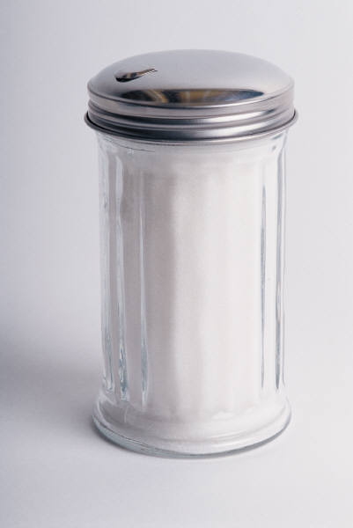
Element, Compound, or Mixture?
Table Sugar

Slide 21
Element, Compound, or Mixture?
Table Sugar
C₁₂H₂₂O₁₁

Slide 22
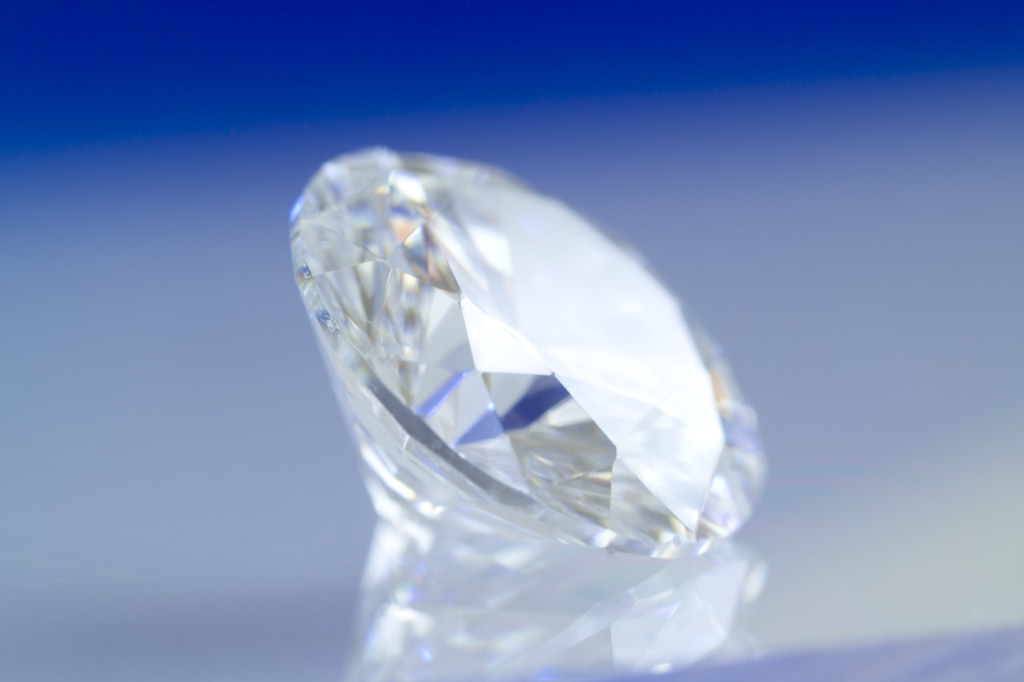
Element, Compound, or Mixture?
Diamond

Slide 23
Element, Compound, or Mixture?
Diamond
C

Slide 24
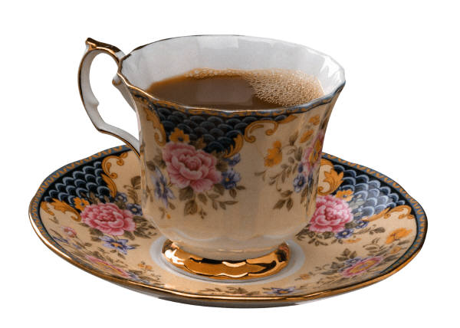
Element, Compound, or Mixture?
Tea

Slide 25
Element, Compound, or Mixture?
Tea

Slide 26
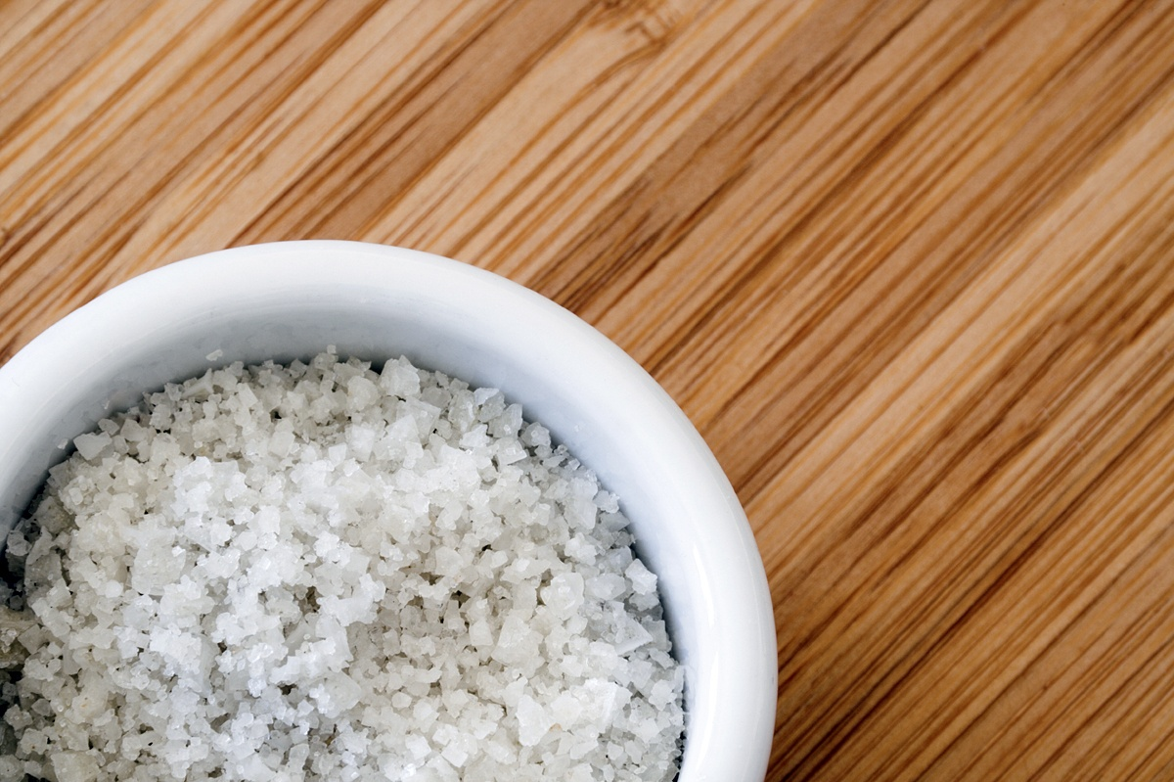
Element, Compound, or Mixture?
Salt

Slide 27
Element, Compound, or Mixture?
NaCl
Salt

Slide 28

Element, Compound, or Mixture?
Neon Gas

Slide 29
Element, Compound, or Mixture?
Ne
Neon Gas

Slide 30
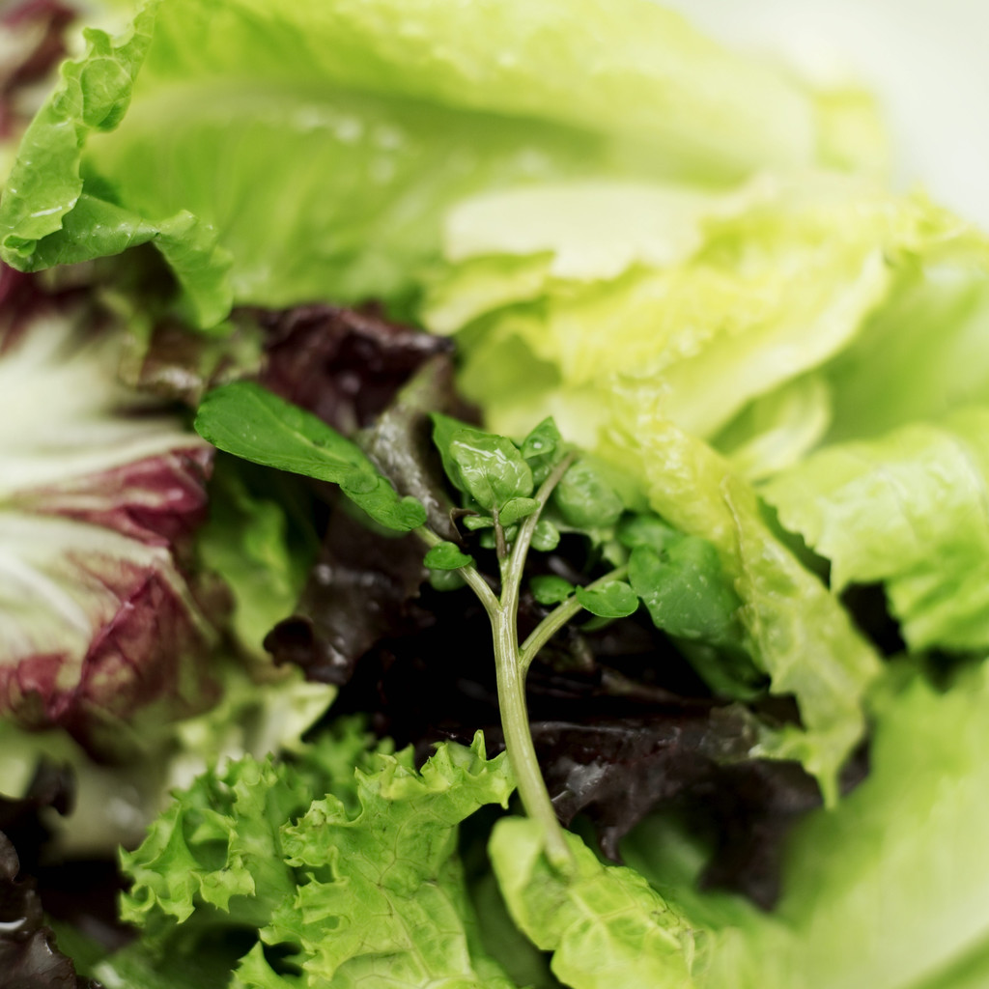
Element, Compound, or Mixture?
Salad

Slide 31
Element, Compound, or Mixture?
Salad

Slide 32
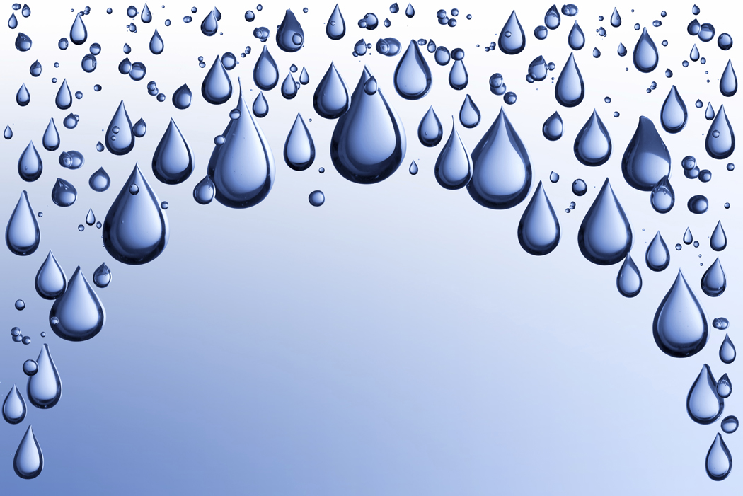
Element, Compound, or Mixture?
Pure Water

Slide 33
Element, Compound, or Mixture?
Pure Water
H₂O

Slide 34
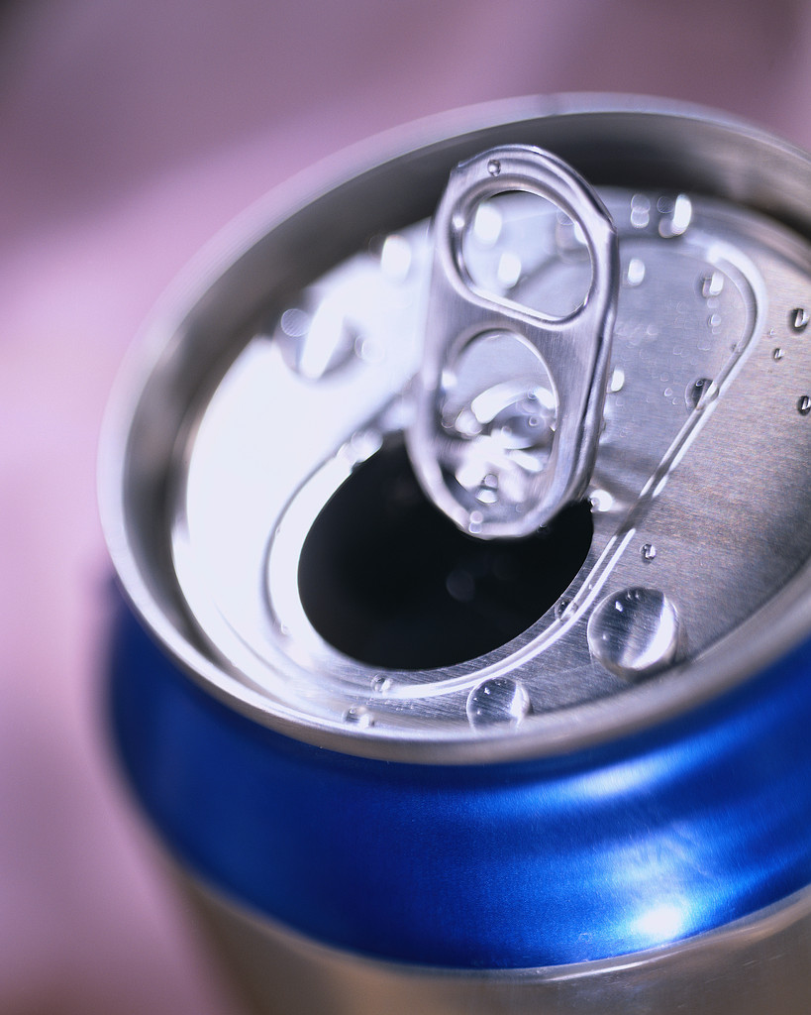
Element, Compound, or Mixture?
Aluminum

Slide 35
Element, Compound, or Mixture?
Aluminum
Al

Slide 36
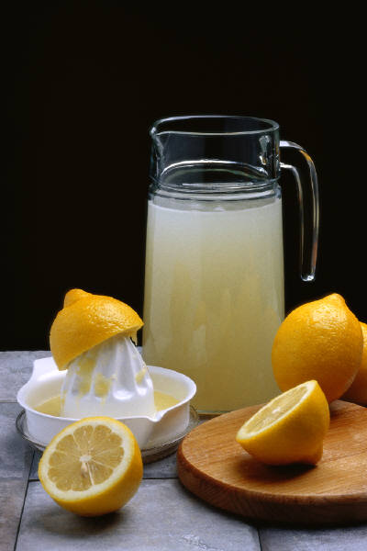
Element, Compound, or Mixture?
Lemonade

Slide 37
Element, Compound, or Mixture?
Lemonade

Slide 38
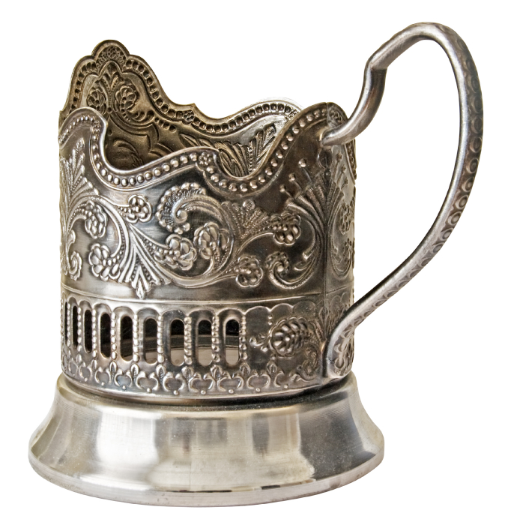
Element, Compound, or Mixture?
Silver

Slide 39
Element, Compound, or Mixture?
Silver
Ag

Slide 40

Element, Compound, or Mixture?
Sand

Slide 41
Element, Compound, or Mixture?
Sand

Slide 42
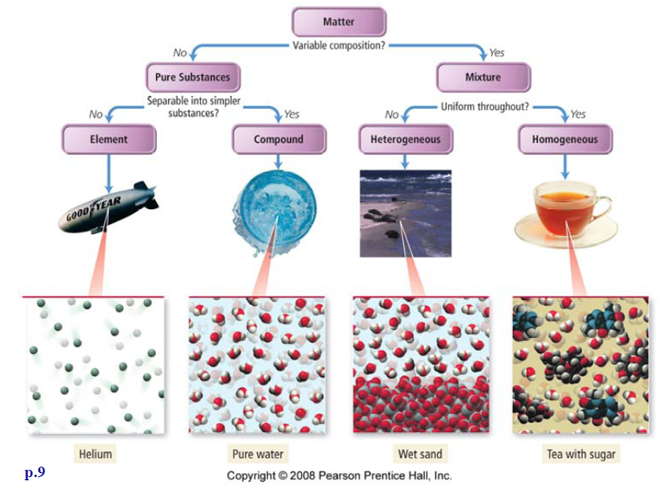

Slide 43
ELEMENT CHOICE PROJECTS
“Adopt” an element research
Choice project

Slide 44
Matter crash course kids
https://youtu.be/wyRy8kowyM8

Slide 45
Properties and Changes of Matter
Unit 2 Continued

Slide 46
Physical Properties
Physical property: characteristic that you can observe without changing or trying to change the composition of the substance.
  Look, smells, sounds, or tastes

Slide 47
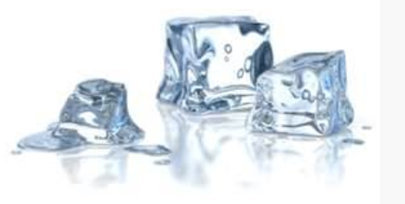
Physical Properties
To describe matter, you must identify its “state”
  Solid Liquid or Gas

Slide 48
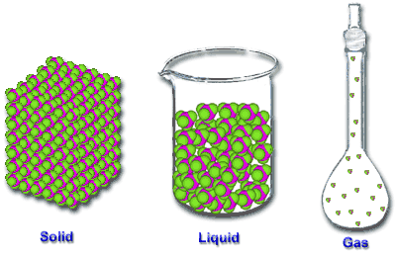
The 3 states of matter and their atom arrangements:

Slide 49
Size dependent and independent physical properties
Size dependent properties(size matters): Volume and Mass
Size independent properties(size doesn’t matter): Density, melting/boiling points, solubility, ability to attract magnet, state of matter, and color.

Slide 50
Physical Changes
Physical change is when the form or appearance of matter changes , but not the composition.
  Changing shape: Play-dough
  Dissolving: Sugar/tea
  Changing state: ice to water to gas

Slide 51
Physical Changes
Changes in State
  Vaporization- liquid to gas
  Condensation-gas to liquid
  Sublimation-solid directly to gas
  Deposition-gas directly to a solid

Slide 52
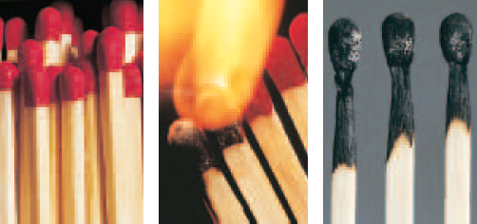
Chemical Properties
A chemical property can only be observed while watching a chemical change.
Matches:

Slide 53
Other examples of chemical reactions
http://www.teachertube.com/viewVideo.php?video_id=61727
So what are some chemical properties we can observe??

Slide 54
Chemical Changes
A chemical change occurs when the substance is changed into a completely different substance.
Signs of a chemical change:
Color
Energy
Odor
Gases or solids
Not easily reversed

Slide 55
Compare and contrast
Make a Venn diagram to compare and contrast physical -vs- chemical properties.

Slide 56
Physical vs Chemical Changes
Law of conservation of mass:
    The total amount of mass before and after any physical or chemical change stays the same.
    Particles in a substance are simply rearranged.

Slide 57
Demo Day

